Slide 1


SAPTHAGIRI COLLEGE OF ENGINEERING
(Affiliated to Visvesvaraya Technological University, Belagavi& Approved by AICTE, New Delhi)(Accredited by NAAC with “A” grade)(NBA Accredited-CSE,ECE,EEE,ISE,ME)
(An ISO 9001:2015 & ISO 14001:2015 Certified)
Department of Information Science & Engineering
Technical Seminar
Presentation
on
“Intelligent Rover: An IoT Based Smart Surveillance Robotic Car for Military”
Presented by:
Name
Suryansh Kumar Srivastava
USN
1SG20IS100
Under the guidance of
Prof. Gayathri R
Assistant Professor,
Dept. of I.S.E., S.C.E.
2023-24

Slide 2
CONTENTS
ABSTRACT
INTRODUCTION
TECHNICAL BACKGROUND
MERITS
DEMERITS
APPLICATIONS
CONCLUSION
FUTURE ENHANCEMENTS
REFERENCES AND BIBILOGRAPHY

Slide 3
1. ABSTRACT
Intelligent Rover is a military based surveillance robotic car that is trained to detect human beings and weapons while moving according to the user need. Intelligent Rover is controlled via smart phone and uses raspberry pi and Arduino to achieve the mission of the rover. It captures live video using picamera and streams it, which can be viewed from a webpage. The camera can be swiveled horizontally and vertically. Intelligent Rover employs yolo V3 algorithms to detect weapons and persons individually. When it detects any objects, it notifies the user via an email. The DC motors connected to the wheels sets the rover into motion that is controlled through the webpage from smartphone or any other devices. This robotic automobile is also capable of detecting metals via sensors and notifies the same to the user via email.
DEPT. OF I.S.E.,S.C.E Intelligent Rover: An IoT Based Smart Surveillance Robotic Car for Military Page 1

Slide 4
2. INTRODUCTION
IoT technology integrates various devices to share data over the internet, offering extensive applications for human benefit, notably in enhancing security.
Traditional military surveillance methods are complex and costly; IoT innovations like smart snipers, information processing devices, and object detection algorithms have revolutionized military security.
Introducing an intelligent surveillance robotic rover leveraging IoT principles, designed for military surveillance, capable of detecting guns, people, and metals, and streaming live data while sending alerts via email.
The rover employs YOLO V3 algorithm and sensors for object detection, saving lives by assisting troopers in identifying enemies and potential threats, with recorded scenes for future reference.
Controlled via smartphone, the rover's features include maneuverability in all directions, adjustable camera angles, and integration with Flask for unified control, promising enhanced military operations.
DEPT. OF I.S.E.,S.C.E Intelligent Rover: An IoT Based Smart Surveillance Robotic Car for Military Page 2

Slide 5
3. TECHNICAL BACKGROUND
PROBLEM STATEMENT:
Developing cost-effective and efficient military surveillance solutions leveraging IoT technology to overcome the complexities and expenses associated with traditional methods, ensuring enhanced detection and response capabilities for safeguarding personnel and assets.
DESIGN
STEPS
1. Define the requirements and specifications of the intelligent surveillance robotic rover.
2. Choose appropriate hardware components including sensors, camera, and IoT modules.
3. Develop the IoT communication protocol for data transmission and control.
4. Implement the YOLOv3 algorithm for detecting guns and people.
5. Integrate sensors for detecting metals and develop algorithms for processing the data.
DEPT. OF I.S.E.,S.C.E Intelligent Rover: An IoT Based Smart Surveillance Robotic Car for Military Page 3

Slide 6
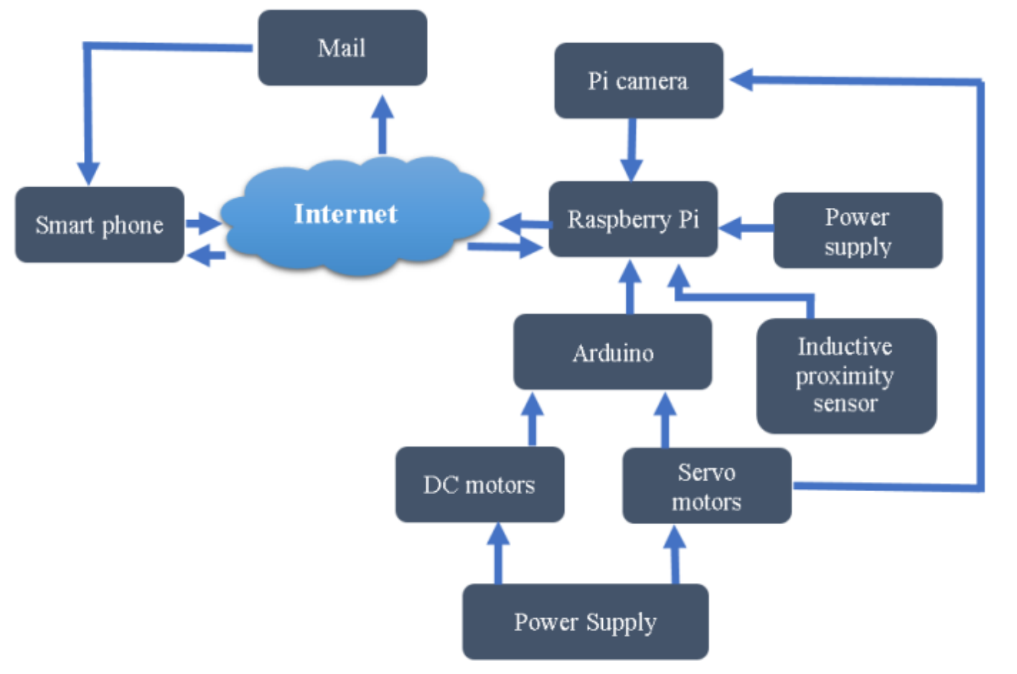
Continued..
Fig 1. Block diagram of Smart Buggy
DEPT. OF I.S.E.,S.C.E Intelligent Rover: An IoT Based Smart Surveillance Robotic Car for Military Page 4

Slide 7
Continued..
STEPS
6. Design the robotic rover's movement mechanism and control system.
7. Implement smartphone control interface for steering and camera control.
8. Develop software for live streaming and email notifications.
9. Test the individual components and functionalities of the robotic rover.
10. Integrate all components and test the complete system.
11. Optimize the system for performance and efficiency.
12. Document the implementation process and create user manuals.
13. Deploy the intelligent surveillance robotic rover in military settings for field testing.
14. Gather feedback from users and make necessary improvements.
15. Finalize the implementation and prepare for mass production or deployment.
DEPT. OF I.S.E.,S.C.E Intelligent Rover: An IoT Based Smart Surveillance Robotic Car for Military Page 5

Slide 8
Continued..
IMPLEMENTATION
The heart of Intelligent Rover is Raspberry Pi 4B+ which comes with high RAM which helps in smooth detection of objects. Raspberry Pi was installed with Raspbian Buster. For object detection, OpenCV4 library was installed. All the codes associated with the movement of the rover and camera were implemented on Arduino IDE and was uploaded into Arduino Nano. The images used to train the model were taken from Open Images v6 dataset that offers a wide-range of images of different categories. The images were labelled and annotated by coding referred from GitHub. Finally, the rover was converted to a wireless robotic device by replacing all the wired external power supplies as batteries. The Raspberry Pi was powered using 3A, 5V power bank and the servo and DC motors were powered using 8 A batteries.
.
DEPT. OF I.S.E.,S.C.E Intelligent Rover: An IoT Based Smart Surveillance Robotic Car for Military Page 6

Slide 9
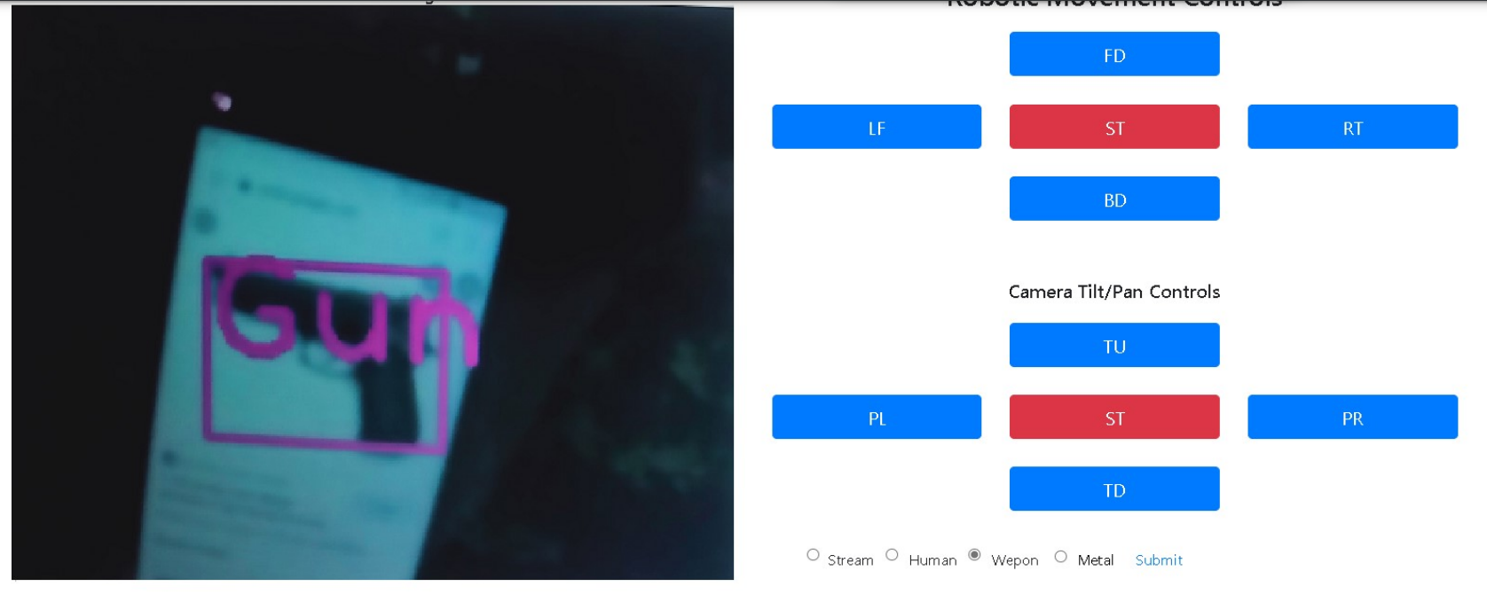
Continued..
.
Fig 2. Webpage to control the Intelligent Rover. The left side shows the detection of gun. The user can switch to person or detection or live stream only section.
DEPT. OF I.S.E.,S.C.E Intelligent Rover: An IoT Based Smart Surveillance Robotic Car for Military Page 7

Slide 10
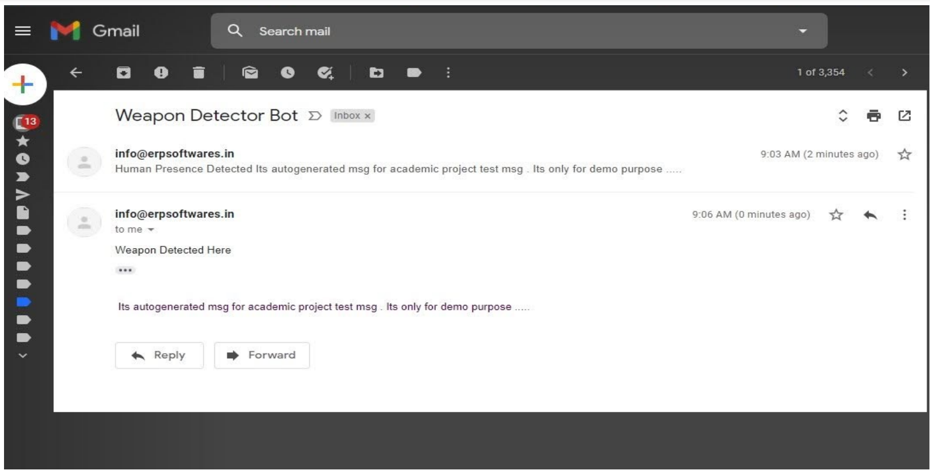
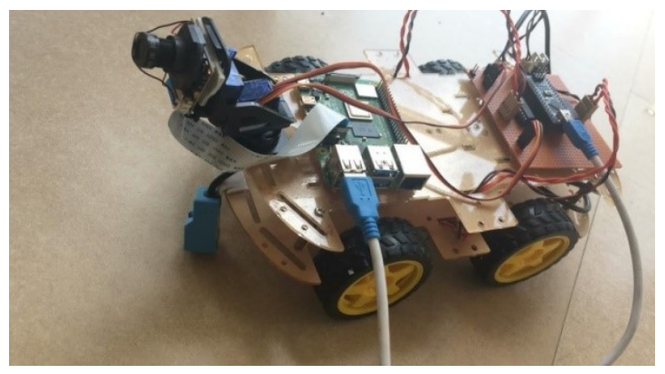
Continued..
.
Fig 4. Model of Intelligent Rover
Fig 3. Email received that shows the presence of weapon and human.
DEPT. OF I.S.E.,S.C.E Intelligent Rover: An IoT Based Smart Surveillance Robotic Car for Military Page 8

Slide 11
4. MERITS
Enhanced Security: The Intelligent Rover contributes to military security by efficiently detecting intruders and weapons, aiding defense personnel in safeguarding their lives and protecting the country.
Real-time Surveillance: It provides real-time surveillance capabilities through live video streaming, enabling immediate awareness of potential threats.
Versatility: The rover's capabilities extend beyond military applications, offering potential use in surveillance for civilian security, rescue operations, and remote monitoring.
IoT Integration: Leveraging IoT principles, the rover can be controlled remotely via smartphone, allowing for flexible deployment and operation.
Object Detection: Utilizing YOLOv3 algorithm, the rover achieves accurate detection of guns and people, enhancing its effectiveness in threat identification.
Email Notifications: The system notifies users via email upon detecting objects, ensuring timely response and intervention.
DEPT. OF I.S.E.,S.C.E Intelligent Rover: An IoT Based Smart Surveillance Robotic Car for Military Page 9

Slide 12
5. DEMERITS
Algorithm Performance: While YOLOv3 offers fast object detection, the processing speed during live streaming may be slow, potentially delaying real-time threat identification.
Complexity of Development: Developing and training the rover involves challenges such as algorithm selection, training data collection, and hardware integration, requiring expertise in multiple domains.
Resource Intensive: Training machine learning models, especially on high-resolution datasets, demands significant computational resources, including high RAM and GPU systems.
Power Dependency: Despite efforts to convert the rover into a wireless device, it still relies on external power sources such as batteries, which may impose limitations on operational duration and mobility.
Deployment Constraints: The rover's effectiveness may be hindered by environmental factors such as terrain conditions, weather, and obstacles, affecting its ability to traverse and surveil certain areas effectively.
DEPT. OF I.S.E.,S.C.E Intelligent Rover: An IoT Based Smart Surveillance Robotic Car for Military Page 10

Slide 13
6. APPLICATIONS
Application of the Intelligent Rover:
Military Surveillance and Security:
Border Patrol
Base Protection
Tactical Operations
Weapon Detection
Civilian Security and Emergency Response:
Law Enforcement Support
Search and Rescue
Industrial Security
General Surveillance and Monitoring:
Private Property Security
Wildlife Monitoring
Environmental Monitoring
DEPT. OF I.S.E.,S.C.E Intelligent Rover: An IoT Based Smart Surveillance Robotic Car for Military Page 11

Slide 14
7. CONCLUSION
In conclusion, the Intelligent Rover represents a significant advancement in surveillance technology, offering a versatile and effective solution for enhancing security and monitoring in both military and civilian contexts. With its capability to detect intruders, weapons, and other threats in real-time using advanced algorithms like YOLOv3, coupled with features such as live video streaming and email notifications, the rover provides valuable situational awareness and response capabilities. Beyond military applications, its potential extends to areas such as law enforcement support, search and rescue operations, and environmental monitoring. Despite some challenges in algorithm performance and resource requirements, the Intelligent Rover stands as a promising tool for safeguarding lives, protecting assets, and maintaining security in a wide range of scenarios.
DEPT. OF I.S.E.,S.C.E Intelligent Rover: An IoT Based Smart Surveillance Robotic Car for Military Page 12

Slide 15
8. FUTURE ENHANCEMENTS
Future enhancements for the Intelligent Rover could focus on improving its autonomy and adaptability to diverse environments. This could involve integrating advanced artificial intelligence and machine learning algorithms to enhance object detection accuracy and speed, as well as implementing autonomous navigation capabilities to enable the rover to navigate complex terrain autonomously. Additionally, enhancing the rover's sensor suite to include additional sensors for environmental monitoring, such as gas sensors or radiation detectors, would expand its utility in various applications. Moreover, incorporating advanced communication capabilities for seamless integration with existing military or civilian networks would further enhance its effectiveness in collaborative operations. Finally, continuous refinement of the rover's hardware and software components to optimize power efficiency, ruggedness, and reliability would ensure its robust performance in challenging conditions.
DEPT. OF I.S.E.,S.C.E Intelligent Rover: An IoT Based Smart Surveillance Robotic Car for Military Page 13

Slide 16
9. REFERENCES AND BIBILOGRAPHY
[1]Bhomble, B., Katkar, S., Dhere, D., Arage, G., Bagwan, S., & Jadhav, M. (2017). IoT based smart sniper. In 2017 International Conference on ISMAC (IoT in Social, Mobile, Analytics and Cloud) (I-SMAC).
[2]P., R., & Bagwari, S. (2018). IoT Based Military Assistance and Surveillance. In 2018 International Conference on Intelligent Circuits and Systems (ICICS).
[3]Ke, C. (2017). Military object detection using multiple information extracted from hyperspectral imagery. In 2017 International Conference on Progress in Informatics and Computing (PIC).
[4]Zhang, C., & Kim, J. (2020). Video Object Detection With Two-Path Convolutional LSTM Pyramid. IEEE Access, 8, 151681-151691.
[5]Rao, B. N., Sudheer, R., Sadhanala, M. A., Tibirisettti, V., & Muggulla, S. (2020). Movable Surveillance Camera using IoT and Raspberry Pi. In 2020 11th International Conference on Computing, Communication and Networking Technologies (ICCCNT).
DEPT. OF I.S.E.,S.C.E Intelligent Rover: An IoT Based Smart Surveillance Robotic Car for Military Page 14

Slide 17
THANK YOU

